Slide 1
The prediction of client subscribed a term deposit
Analyzed by Allison

Slide 2
Contents
Motivation & Goal
Dataset Information
Statistical Analysis
Model
Conclusion

Slide 3
Motivation & Goal
Motivation
Have a preliminary understanding of bank marketing dataset.
Through analysis to understand the impact of these variables on the predictive model.
Goal
Has the client subscribed a term deposit?

Slide 4
Dataset Information
The data is related with direct marketing campaigns (phone calls) of a Portuguese banking institution.
There are 41188 examples in this data.
There are 10 numeric variables and 10 categorical variables.
Data is ordered by date (from May 2008 to November 2010).
4 attributes: “Bank client” “Related with the last contact of the current campaign” “Others” “Social and economic context”
The output variable Y is defined as whether the client subscribed a term deposit.
*The complete information is presented in another powerpoint named “Data Information”.

Slide 5
4 Attributes
Bank client
age
job
marital
Education
default
housing
loan
Related with the last contact of the current campaign
contact
month
day_of_week
duration
Others
campaign
pdays
previous
poutcome
Social and economic context
emp.var.rate
cons.price.idx
cons.conf.idx
euribor3m
nr.employed

Slide 6
Statistical Analysis
This part is that we want to know the disribution of data and relation between each variable and “y“. There are some method used:
Descriptive Statistics
Measures of Dispersion
Graph
Hypothesis Testing
t test
Chi-square test
Fisher’s exact test
Measures of Central Tendency
Measures of Relative Position

Slide 7
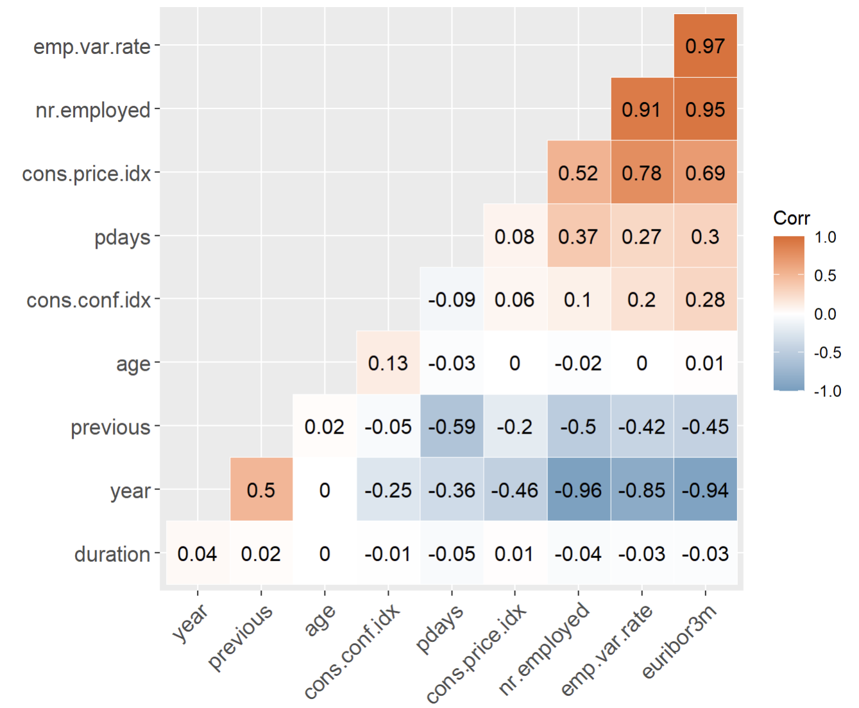
Correlation between continuous variables
Variables in “Social and economic context” are positively correlated with each other and negatively correlated with “Year” and “previous”.
“age” and “duration” are less correlated with other variables.
“pdays” are positively correlated with variables in “Social and economic context” and negatively correlated with other variables .

Slide 8
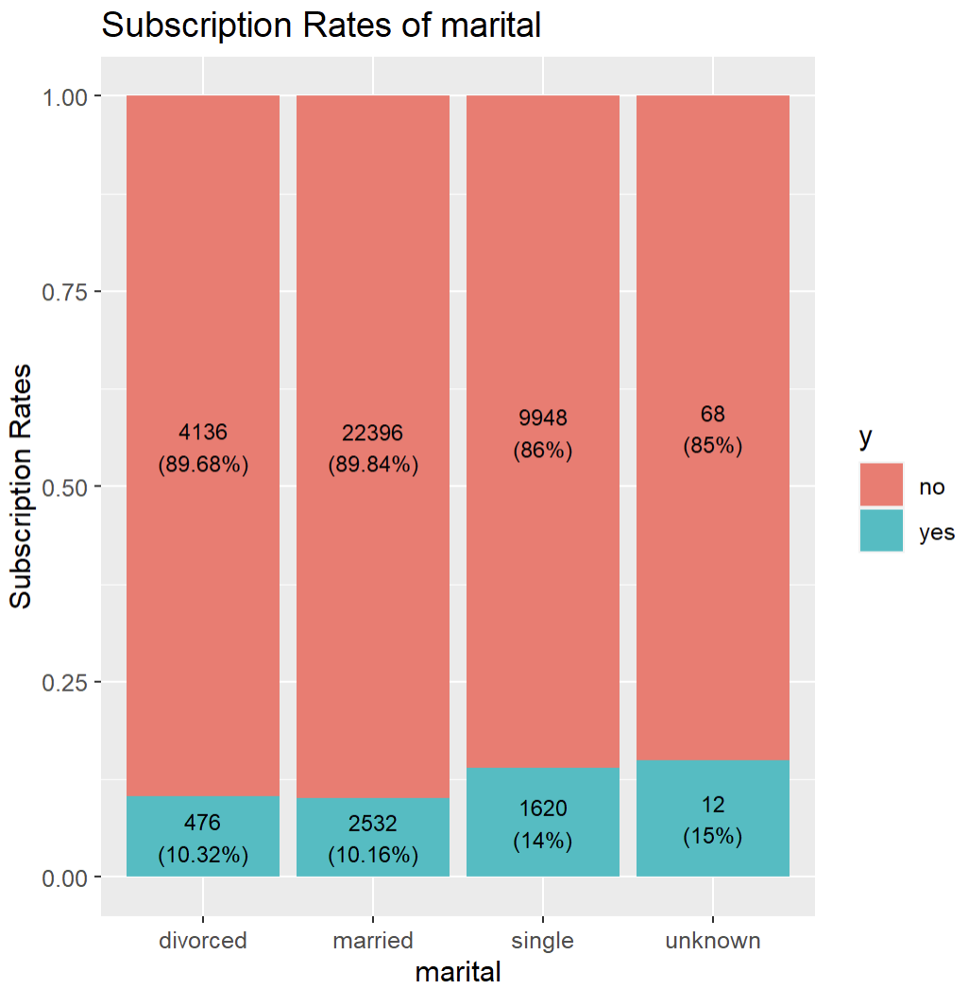
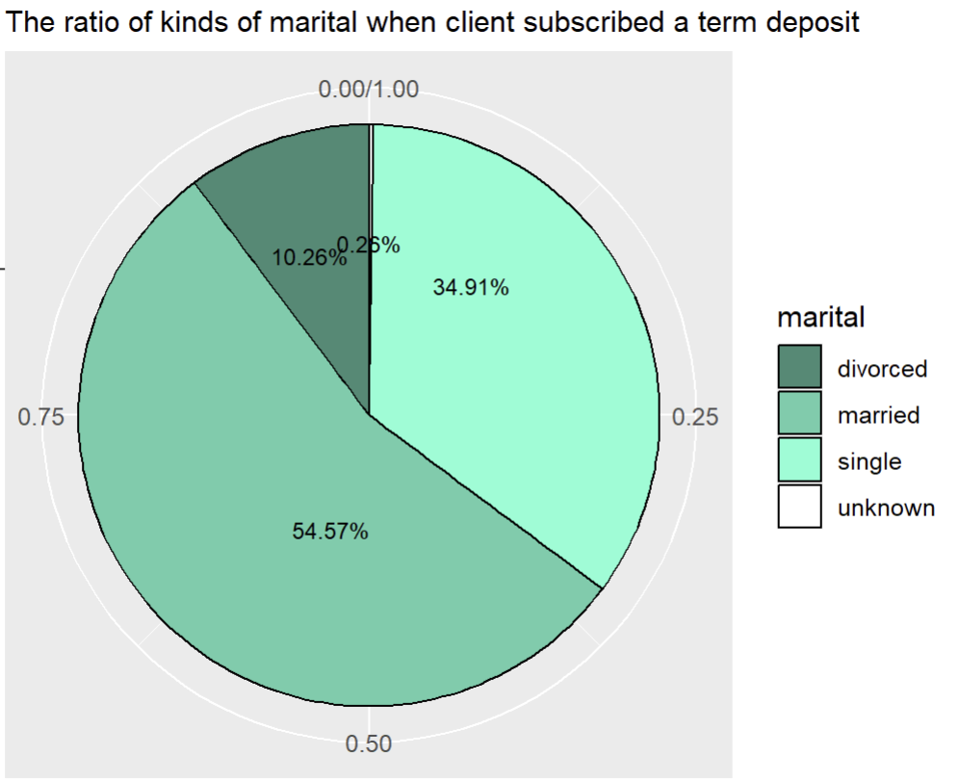
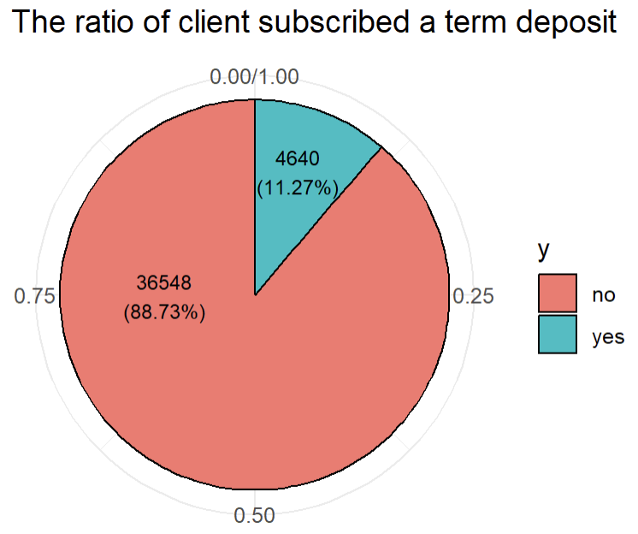
Y & Marital
Single clients subscribed the term deposit is often than others.
The least subscription rates of term deposit is married clients but which also has 2532 people. And for people who subscribed the term deposit, married takes over than 50%. → It is also important to pay attention to married clients.
Among the 41,188 clients, 4640 of them subscribed the term deposit, which accounts for 11.27%.

Slide 9
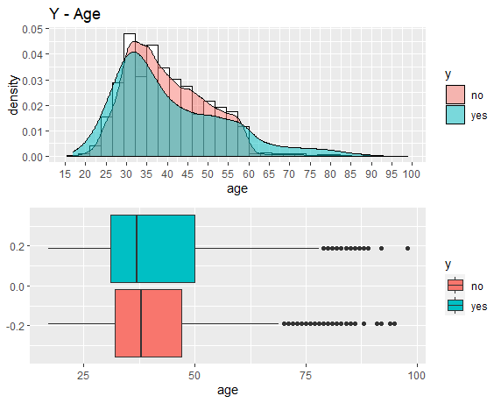
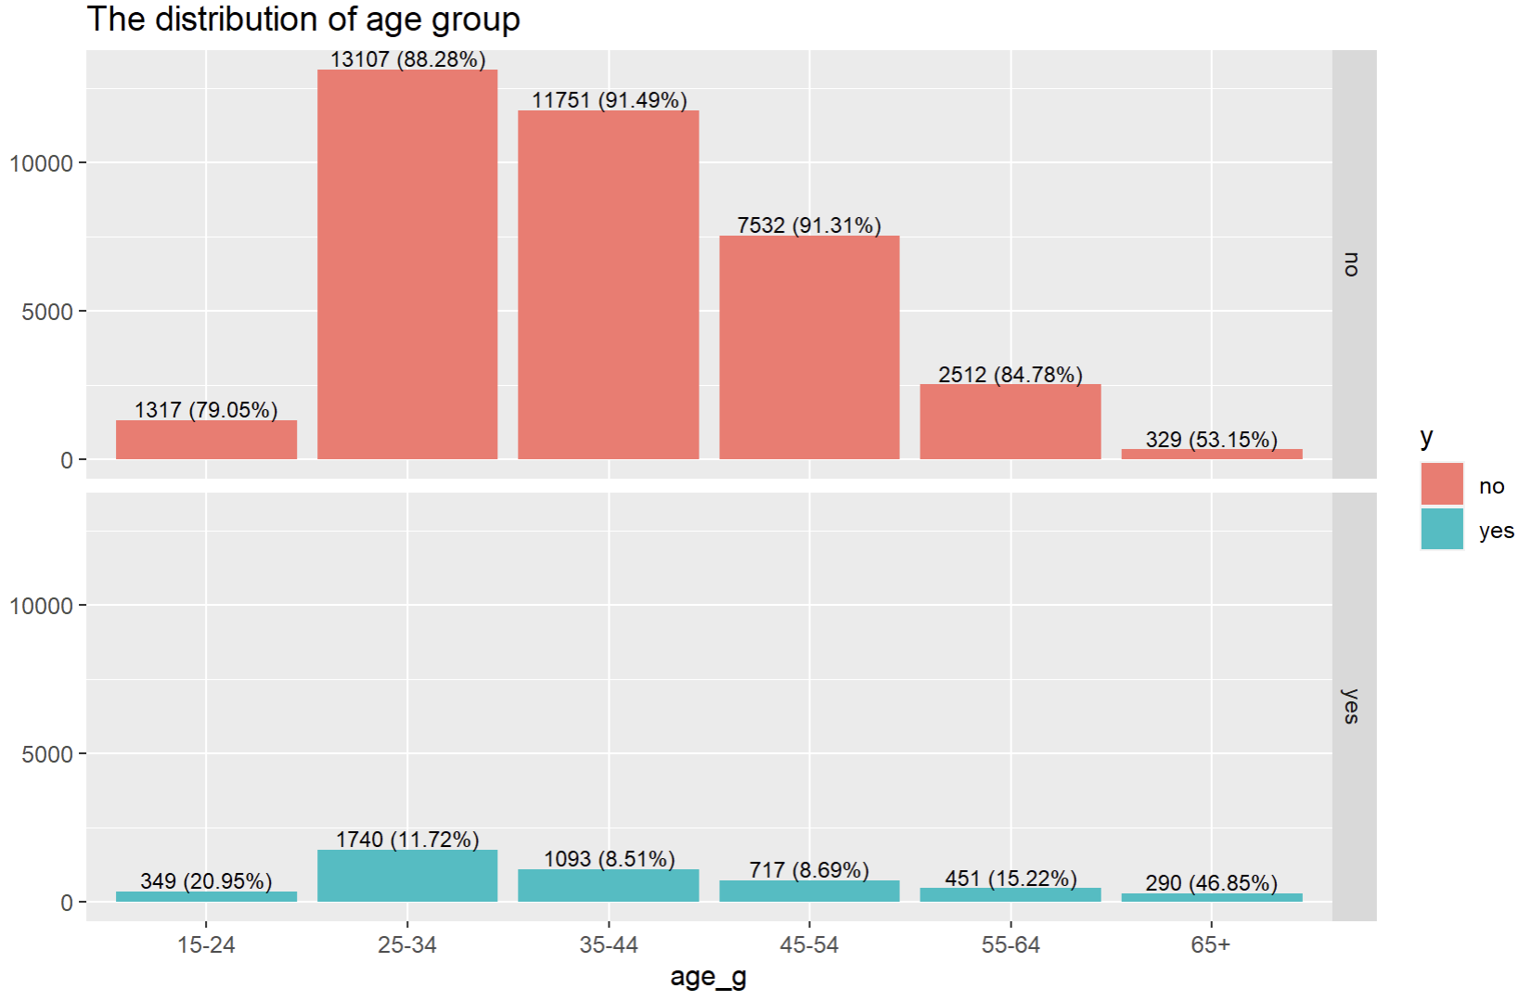
age
age | y | n | Min. | 1st Qu. | Median | Mean | 3rd Qu. | Max. | IQR | stdev | var
age | Yes | 4640 | 0.617 | 4.217 | 7.483 | 9.22 | 12.354 | 69.983 | 8.137 | 6.686 | 44.705
 | No | 36548 | 0 | 1.583 | 2.725 | 3.681 | 4.65 | 81.967 | 3.067 | 3.452 | 11.914
Most bank customers are between the ages of 25 and 60.
“25-34” is the most numbers of who subscribed term deposits but the highest proportion is “65+”.

Slide 10
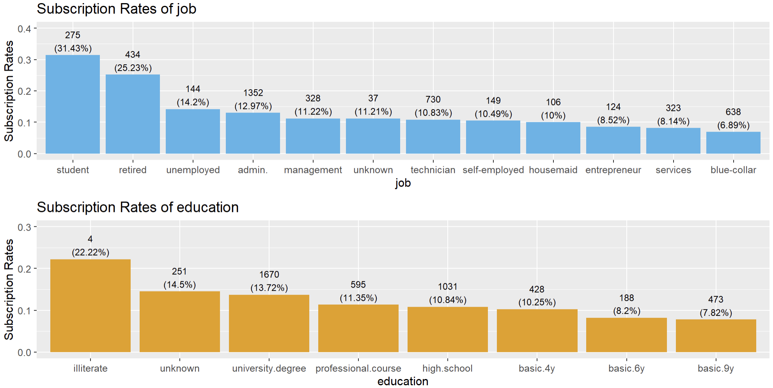
Job & education
The subscription rate in job and education means that the rate of subscribed term deposits in the same category. For example, there is 31.43% of all student subscribed term deposits.
For job, the top 3 subscription rates of term deposit are students, retired people and unemployed.
The subscription rate of blue-collar is only 6.89%. → Indicating low demand for this service.
For education, the most subscription rates of term deposit is illiterate but which just has 4 people.
The second is unknown which means we can not ignore these clients.
Surprisingly, basic.4y is higher than basic.6y and basic.9y.

Slide 11
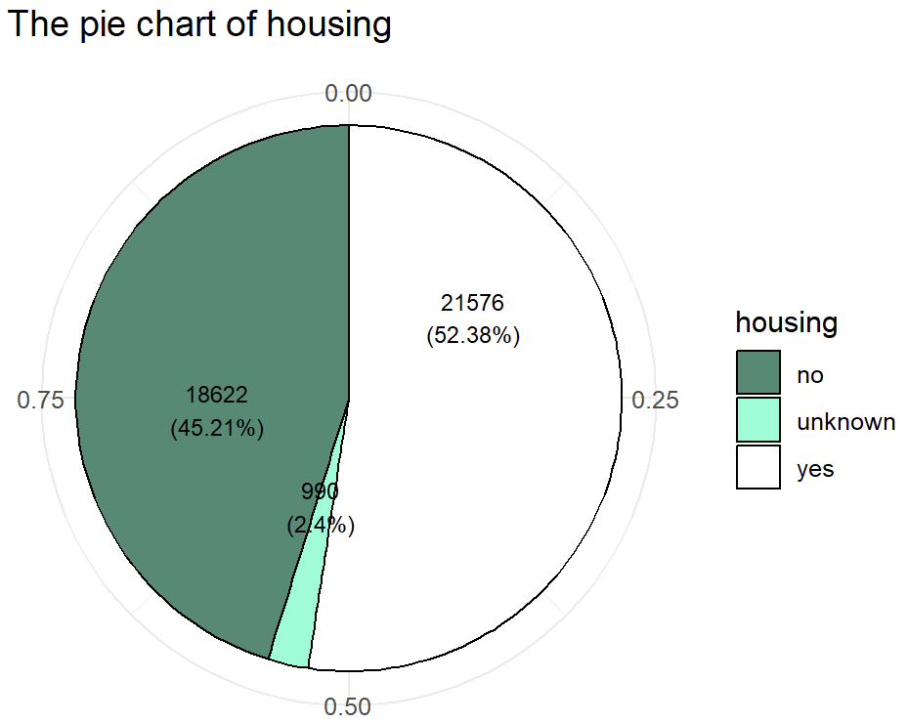
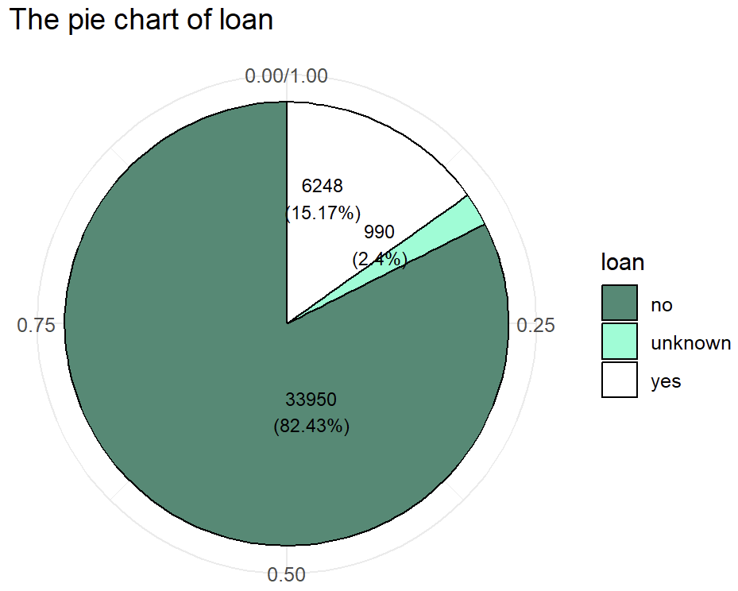
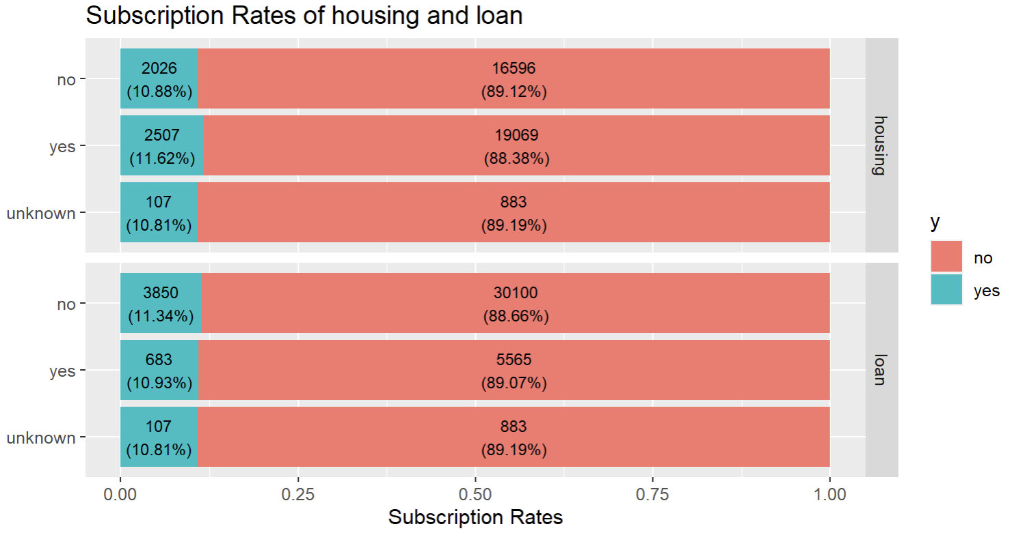
Housing & Loan
There are over than 50% people who have housing loan, and about 15% people who have personal loan.
In housing and loan, subscription rates of each class are around 9:1. → Regardless of whether a client has “housing” or “loan”, it will not have much impact on subscribing to the term deposit.

Slide 12
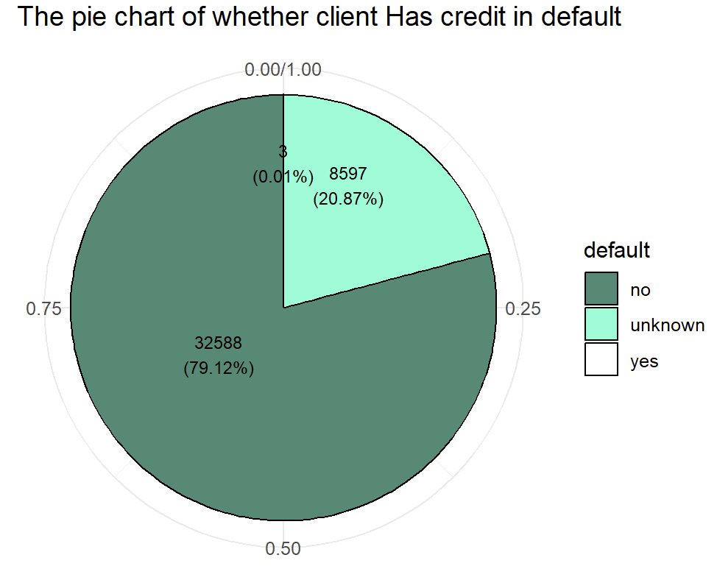
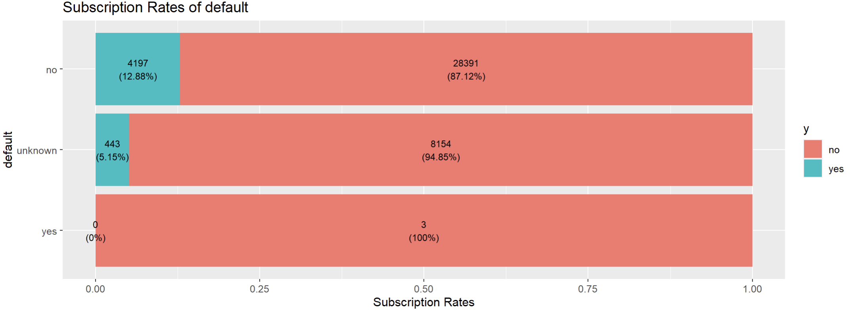
Default
Unknown is around 21%, and there is 5.15% of unknown subscribed the term deposit. → It needs to impute the missing value.
There are only 3 client has credit in default.
The subscription rate of that clients does not have credit in default takes 12.88%.

Slide 13
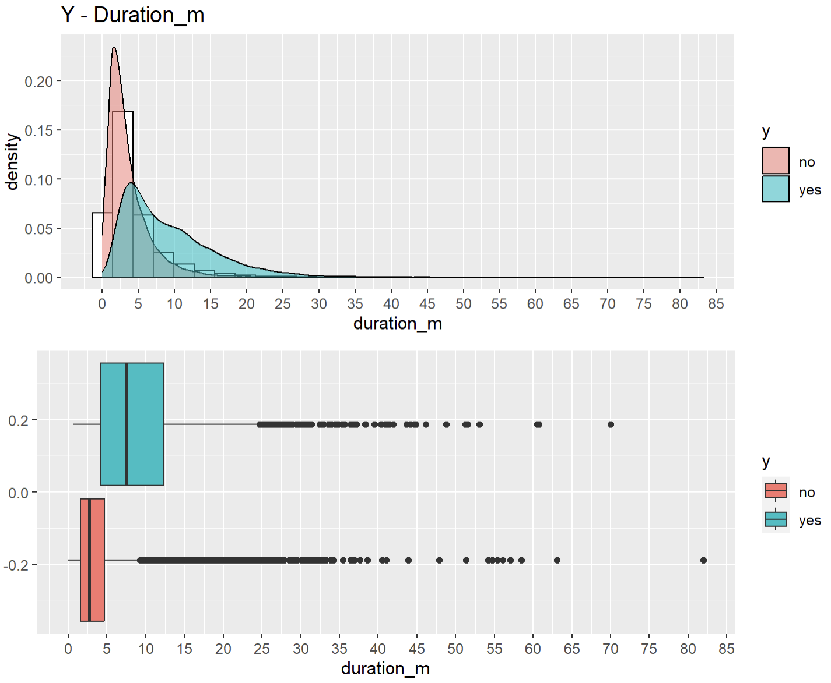
duration_m
duration_m | y | n | Min. | 1st Qu. | Median | Mean | 3rd Qu. | Max. | IQR | stdev | var
age | Yes | 4640 | 0.617 | 4.217 | 7.483 | 9.22 | 12.354 | 69.983 | 8.137 | 6.686 | 44.705
 | No | 36548 | 0 | 1.583 | 2.725 | 3.681 | 4.65 | 81.967 | 3.067 | 3.452 | 11.914
For convenience of observation, we convert the unit of duration from seconds to minutes which named “duration_m”.
50% of customers who subscribed a term deposit are concentrated around 5 to 13 minutes. However, 50% of customers not subscribed a term deposit are concentrated around 1.5 to 5 minutes. → The length of the phone call significantly affected the willingness to subscribe to term deposits.

Slide 14
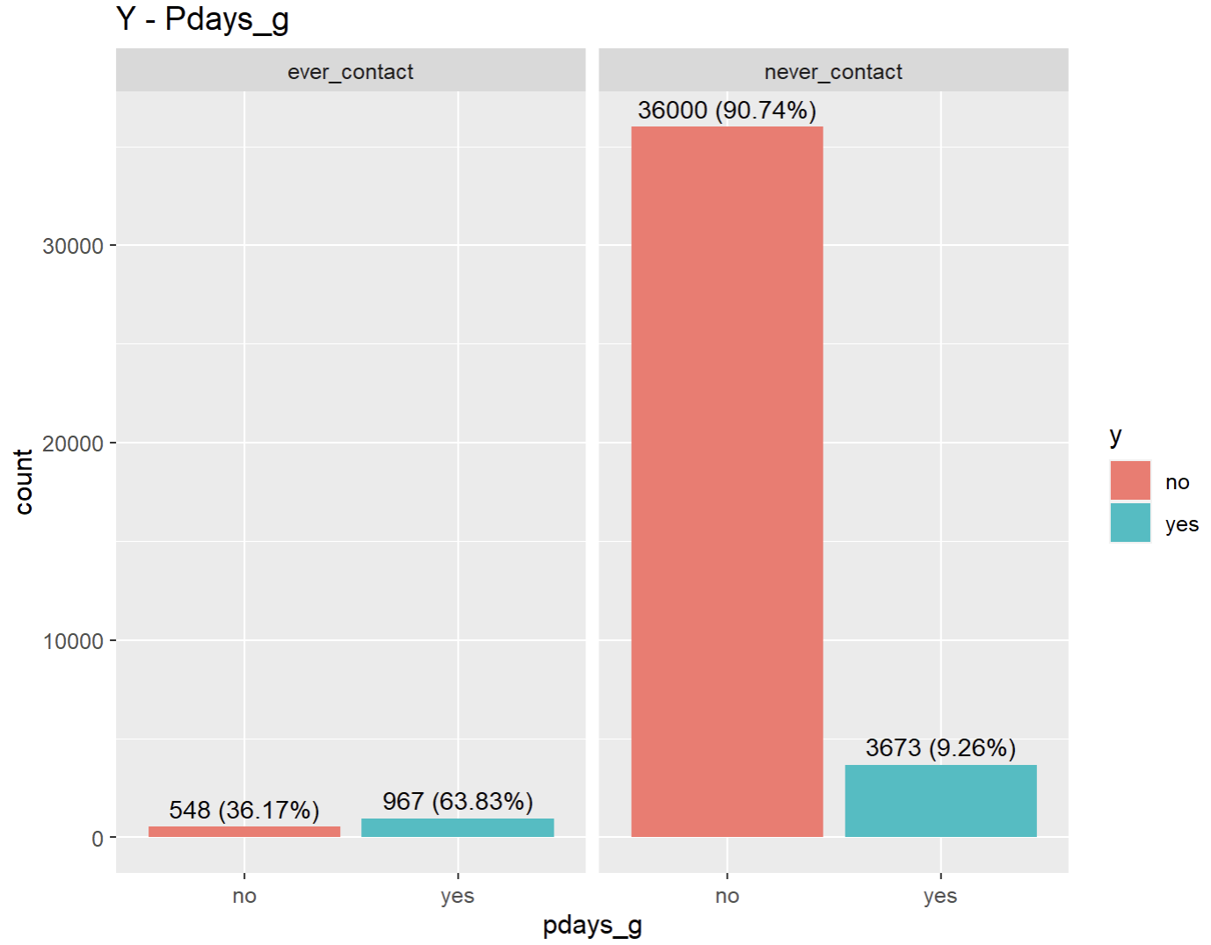
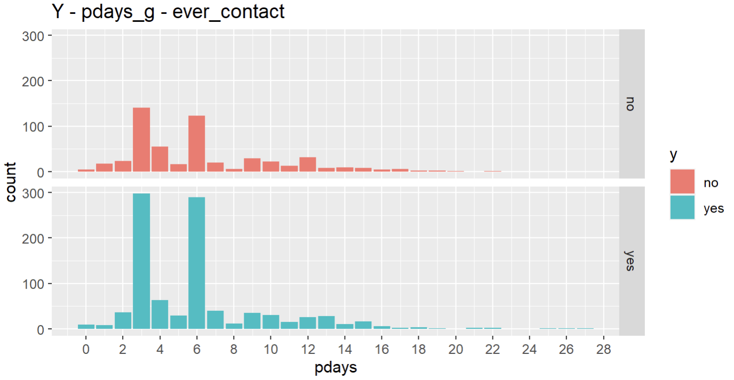
pdays_g
According to whether clients have been contacted before, “pdays” is divided into 2 groups and a new variable “pdays_g” is formed.
In “ever_contact”, it was about 64% client subscribed a term deposit. However, it was just about 10% clients in “never_contact”. → Clients contacted at the last activity have a higher acceptance of this service.
In “ever_contact”, nearly 600 clients subscripted term deposits were concentrated 3 days or 6 days after the last activity contact.
 |  | pdays_g
 |  | never_contact (0-27) | ever_contact (999)
Y | yes | 3673 | 967
 | no | 36000 | 548

Slide 15
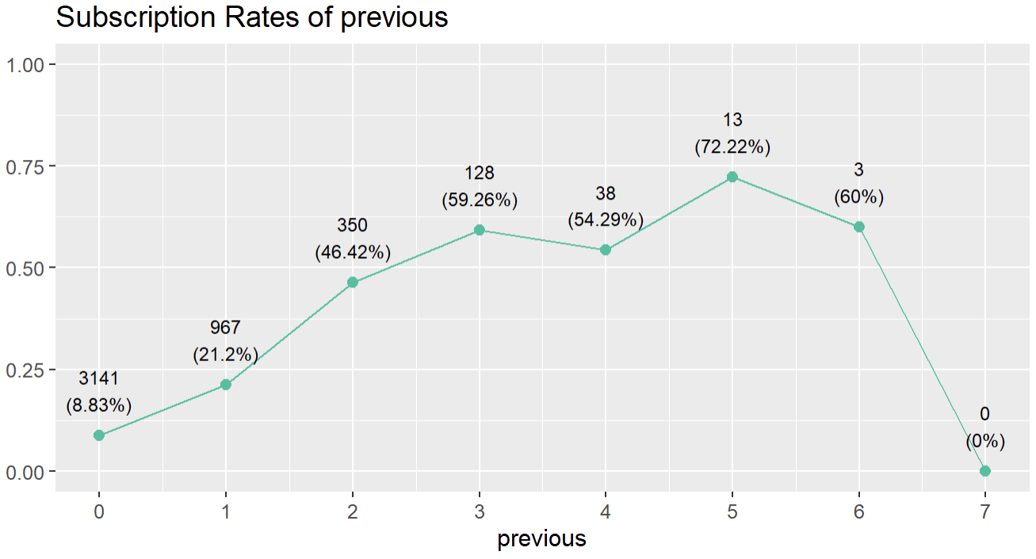
previous
previous | 0 | 1 | 2 | 3 | 4 | 5 | 6 | 7
no | 32422 | 3594 | 404 | 88 | 32 | 5 | 2 | 1
yes | 3141 | 967 | 350 | 128 | 38 | 13 | 3 | 0
The number of times to exclude contacting a customer is 7 times. The more times the clients are contacted before the advertising campaign, the higher the subscription rate of term deposit are.

Slide 16
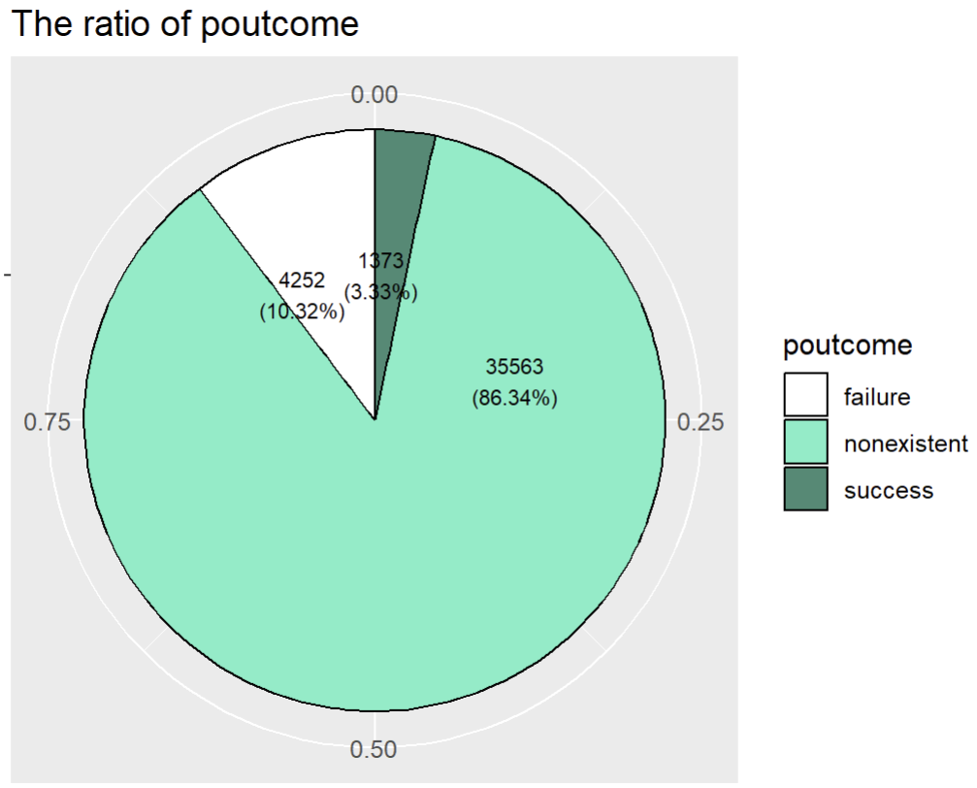
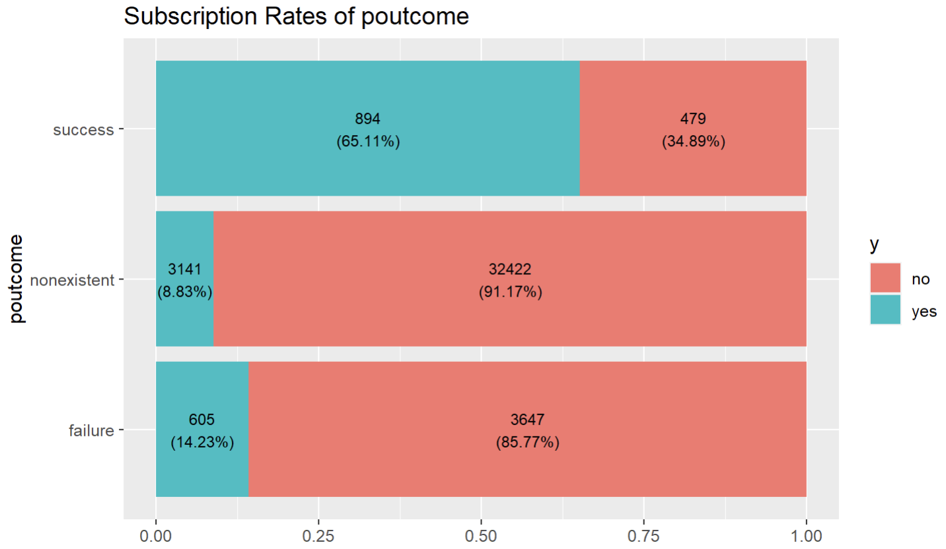
poutcome
In this data, there are 5625 people joined previous marketing campaign and the result of success only 3.33%.
The subscription rate for a term deposit is as high as 65% among the relevant clients who had achieved success in previous marketing campaigns and the subscription rate of “failure” is higher than “nonexistent”. → There is a positive relationship between subscription rate and participation of previous marketing campaigns

Slide 17
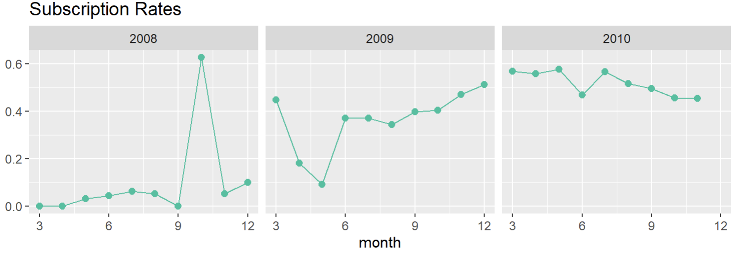
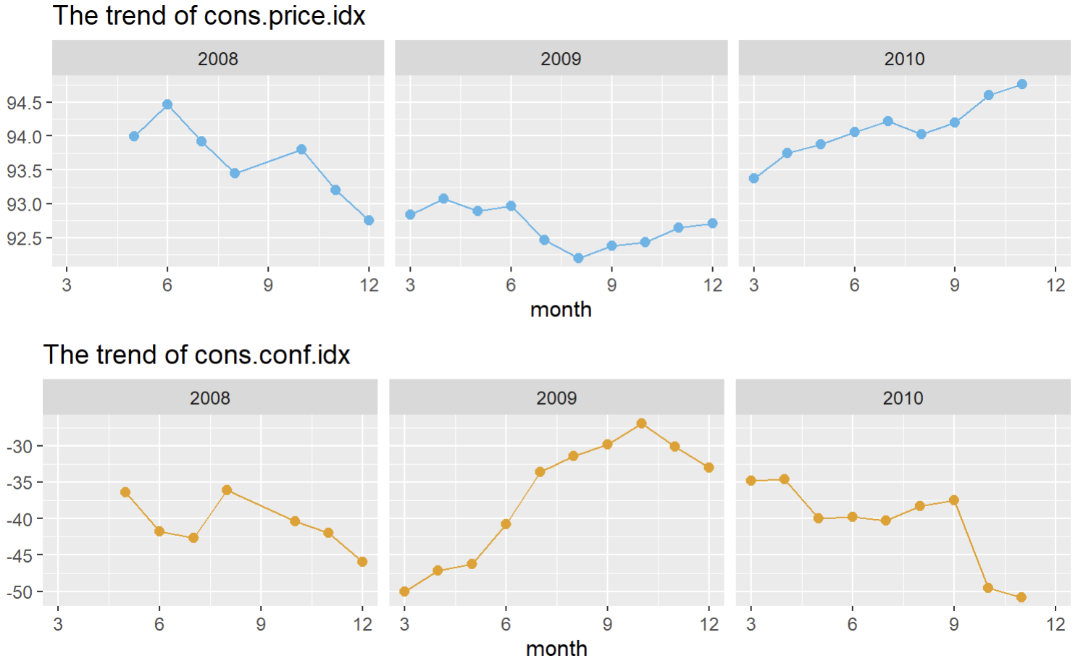
cons.price.idx & cons.conf.idx
In 2008, the trends of both indicators were downward. They were different from the subscription rate which had remained around 5% and suddenly exceeded 60% in October. (Financial crisis of 2007–2008)
In 2009, the overall trend of consumer price index was downward but others began to rise after June. → weak consumer spending power
In 2010, only the trends of consumer confidence index was downward. → People became increasingly less optimistic about current and future economic conditions.

Slide 18
Hypothesis Testing 1
Compare the test results of “age” and “age_g”, both are statistically significant.
According to the test results of 12 variables, "housing" and "loan" are not statistically significant → It means that except for “housing” and “loan”, there are differences of other variables between the two groups with subscription and fixed deposit and without subscription and fixed deposit.
# Y – Each Variable
# Bank Client Attributes
Variables | age | age_g | job | maritial | eduation | default | housing | loan
Test | t test | Chisq | Chisq | Chisq | Fisher | Fisher | Chisq | Chisq
P-value | 1.805e-06 | < 2.2e-16 | < 2.2e-16 | < 2.2e-16 | 0.0004998 | < 2.2e-16 | 0.05829 | 0.5787
# Related with The Last Contact of The Current Campaign Attributes
Variables | contact |  | month |  | day_of_week |  | duration
Test | Chisq |  | Chisq | Chisq | Chisq |  | t test
P-value | < 2.2e-16 |  | < 2.2e-16 |  | 2.958e-05 |  | < 2.2e-16

Slide 19
Hypothesis Testing 2
Compare the test results of “pdays” and “pdays_g”, both are statistically significant.
According to the test results of 10 variables, all of them are statistically significant. → It means that there are differences of all variables between the two groups with subscription and fixed deposit and without subscription and fixed deposit.
# Y - Each Variable
# Other Attributes
Variables | campaign | pdays | pdays_g | previous | poutcome
Test | t test | t test | Chisq | t test | Chisq
P-value | < 2.2e-16 | < 2.2e-16 | < 2.2e-16 | < 2.2e-16 | < 2.2e-16
# Social and Economic Context Attributes
Variables | emp.var.rate | cons.price.idx | cons.conf.idx | euribor3m | nr.employed
Test | t test
P-value | < 2.2e-16 | < 2.2e-16 | < 2.2e-16 | < 2.2e-16 | < 2.2e-16

Slide 20
Model
Data Preprocessing
Training Model
Create New Variables
Check & Impute Missing Value
Model Performance
Feature Selection
Training Data & Testing Data

Slide 21
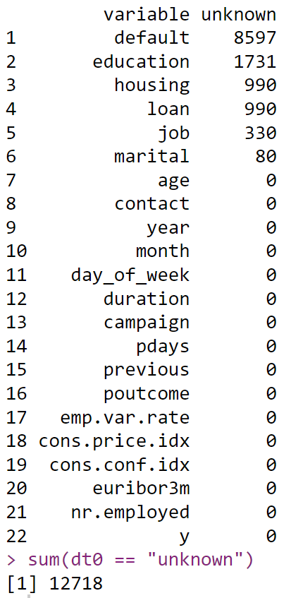
Data Preprocessing
According to the some data information and previous analysis , we do some preprocessing.
Create New Variables
year (because original data is ordered by date)
age_g (split age into groups)
pdays_g (split pdays into 2 groups: “ever_contact”, “never_contact”)
duration_m (convert the unit of “duration” from second to minute)
Check & Impute Missing Value
There are 6 variables which totally have 12718 unknown value.
Use package “mice” to impute missing value.
Missing Value counting

Slide 22
Training Data & Testing Data
The ratio of training data and test data is 8:2.
Feature Selection
Features are selected based on the previous analysis and using LR model with stepwise selection.
Training Model
Model Performance
Model: LR、RF、 DT、 SVM
Validation Index: Accuracy、 Sensitivity、Specificity、PPV、NPV、ROC、AUC

Slide 23
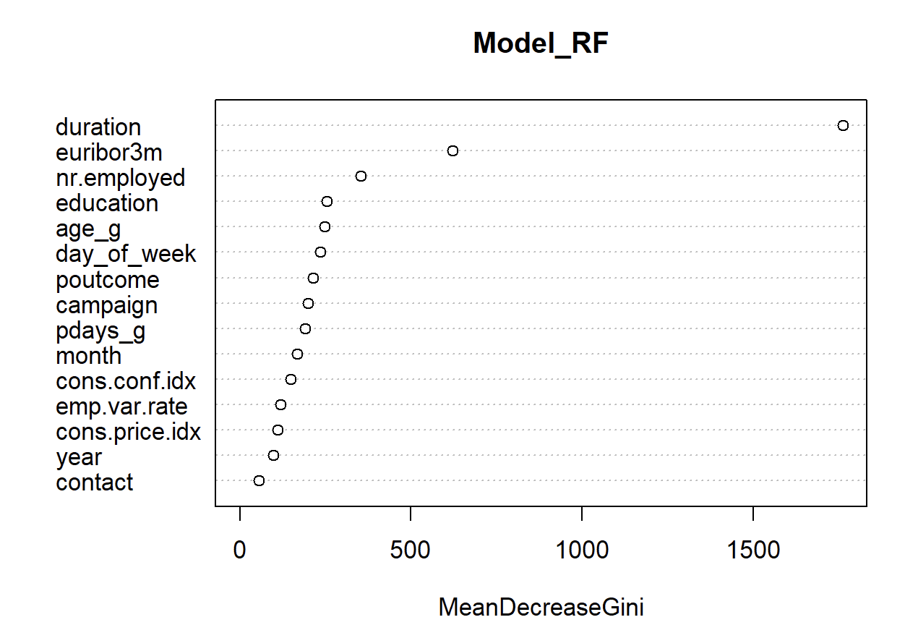
Feature
Selection
The features selected after using LR model with stepwise are put into the RF model, and Mean Decrease Gini is calculated to know the importance of features. → “Duration” is most important than other features.
Final Selected Features
age_g | day_of_week | emp.var.rate
education | duration | cons.price.idx
contact | campaign | cons.conf.idx
year | pdays_g | euribor3m
month | poutcome | nr.employed
Notes:
Mean Decrease Gini: 透過 Mean Decrease Gini 來衡量變數重要性指數，表示 Gini 係數減少的平均值。
在隨機森林中，衡量變數的重要性方法是透過剔除該變數，並將剔除變數的模型與原模型比較，差異越大表示變數越重要。

Slide 24
Model
Performance
According to the table, when the performance of other indicators is very close, the sensitivity of Decision Tree is higher. → This means that among people who actually subscribe to term deposits, decision tree model is more accurate in predicting those who subscribe to term deposits.
Model | Accuracy | Sensitivity | Specificity | PPV | NPV
Logistic Regression | 0.9069 | 0.30411 | 0.98092 | 0.66184 | 0.91986
Random Forest | 0.9170 | 0.47614 | 0.97124 | 0.67031 | 0.93778
Decision Tree | 0.9156 | 0.54828 | 0.96075 | 0.63171 | 0.94541
SVM | 0.9114 | 0.36515 | 0.97847 | 0.67556 | 0.92620

Slide 25
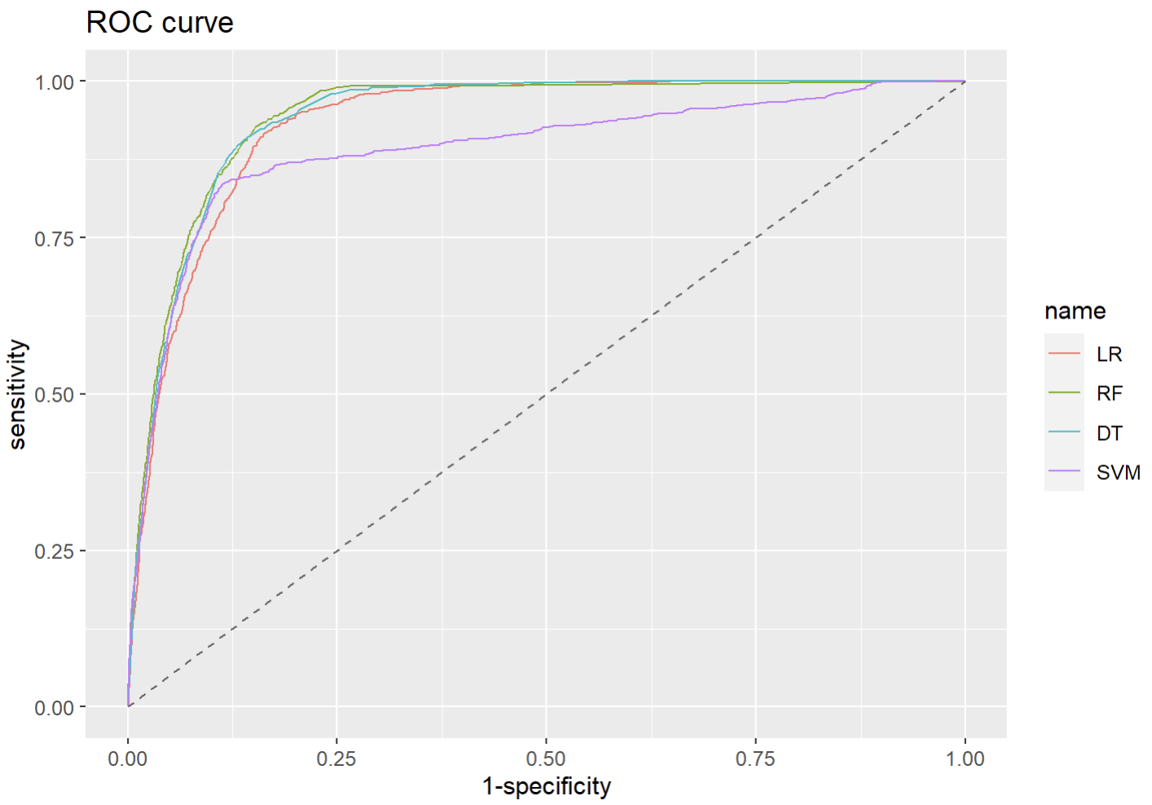
Model
Performance
According to the ROC curve, it is obvious that the performance of random forest and decision tree are better than others.
Though the performances of RF and DT are very close, considering the previous model indicators, the DT will be chosen overall.

Slide 26
Conclusion
Base on the importance calculated by the RF model, “duration" is the most important feature. “euribor3m” is unexpectedly 2nd important feature because it has nothing to do with the subscription rate of term deposit intuitively.
Although the AIC decreased when the automatic model selection method is used, only the sensitivity of DT is over than 0.5.
Since data imbalance will affect sensitivity and fitting results. → Using k-fold cross validation to make fitting of model better.

Slide 27
References
UCI Machine Learning, Bank Marketing, url: https://archive.ics.uci.edu/dataset/222/bank+marketing
JianKai Wang, 隨機森林 (Random Forest), url: https://rpubs.com/jiankaiwang/rf
Kendal Wong, Chapter 24: Decision Trees, url: https://ademos.people.uic.edu/Chapter24.html#34_decision_trees_with_all_variables
Skydome20, R筆記 – (14)Support Vector Machine/Regression(支持向量機SVM), url: https://rpubs.com/skydome20/R-Note14-SVM-SVR
R Documentation, Plot a ROC curve with ggplot2, url: https://rdrr.io/cran/pROC/man/ggroc.html

Slide 28
Thanks

